Slide 1

UNIVERSITY OF PETROLEUM & ENERGY STUDIES
School of Computer Science
Dehradun
COURSE: Physical Security July – December 2023
Delivered by
Dr. Gopal Singh Rawat
1

Slide 2
Course Plan
Introduction to Physical Security
Approaches to Physical Security
Standards, Regulations and Guidelines
Fire and Fire Safety Inspection
Vulnerability Assessment
Security Surveys and Audit
Security Lighting, Alarms Systems
Video, Biometrics, Access Control, Fences
Security Personnel
2

Slide 3
Chapter 7. Security Lighting & Alarm Systems

Slide 4

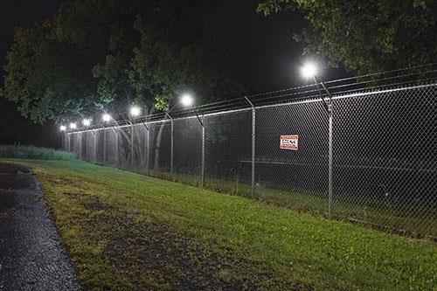
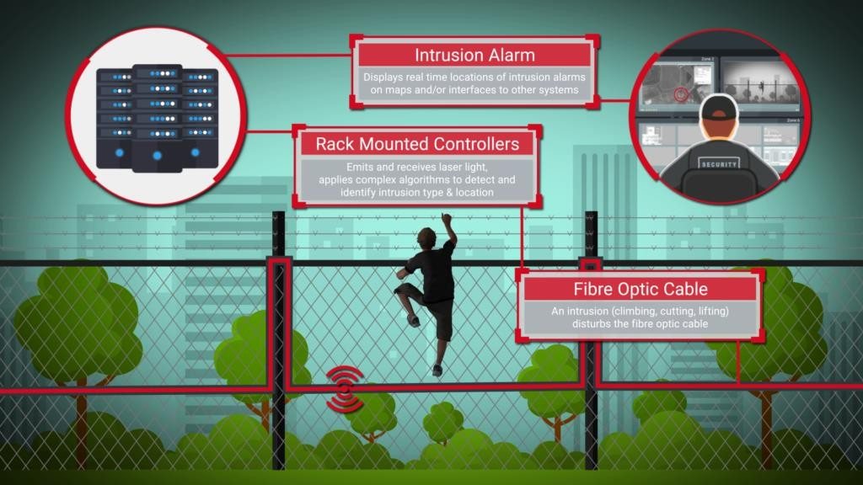
7.1 Security Lighting
Purpose
Creates Intrusion Deterrence → Psychological (Remember: Perception as Security)
Enables Intrusion Detection → Physical H/W (Wires, Lamps, Sensor, Cams, Cables)
Levels of Lighting → Bright Light, Dim Light and Complete Darkness
Question one needs to factor in :
What is the threat faced?
How to provide the protection?
Which sensors can ensure secure environment? How will the intrusion alerts be sent? To whom?

Slide 5
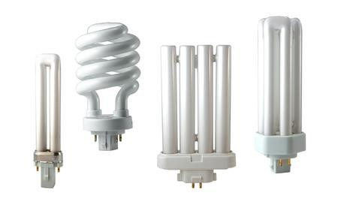
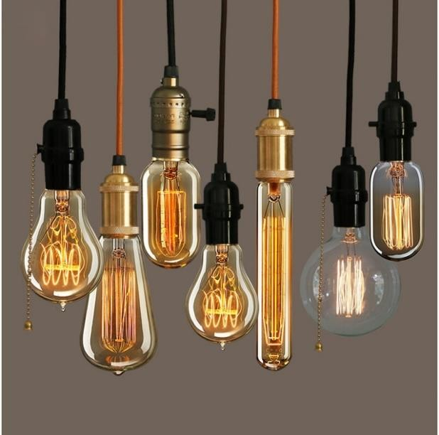
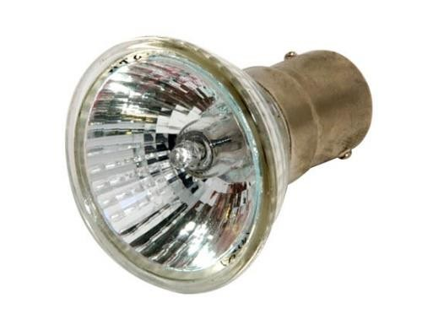
7.2 Security Lighting
Efficiency of lights – measured in Lumens per Watt (new – bright output, high intensity)
Types of mechanisms for lighting: Lamps and Other Lighting Equipment
Lamps
Incandescent – Residence, Filament, Least Efficient, Most Costly, Short life, 10-20 LpW
Halogen –halogen gas, better life– automotive headlamps, work lights (Hotels)
Florescent – have gas trapped inside, costly, 40-80 LpW, no high output level
Incandescent
Halogen
Florescent
Notes:
LpW – Lumens per watt

Slide 6
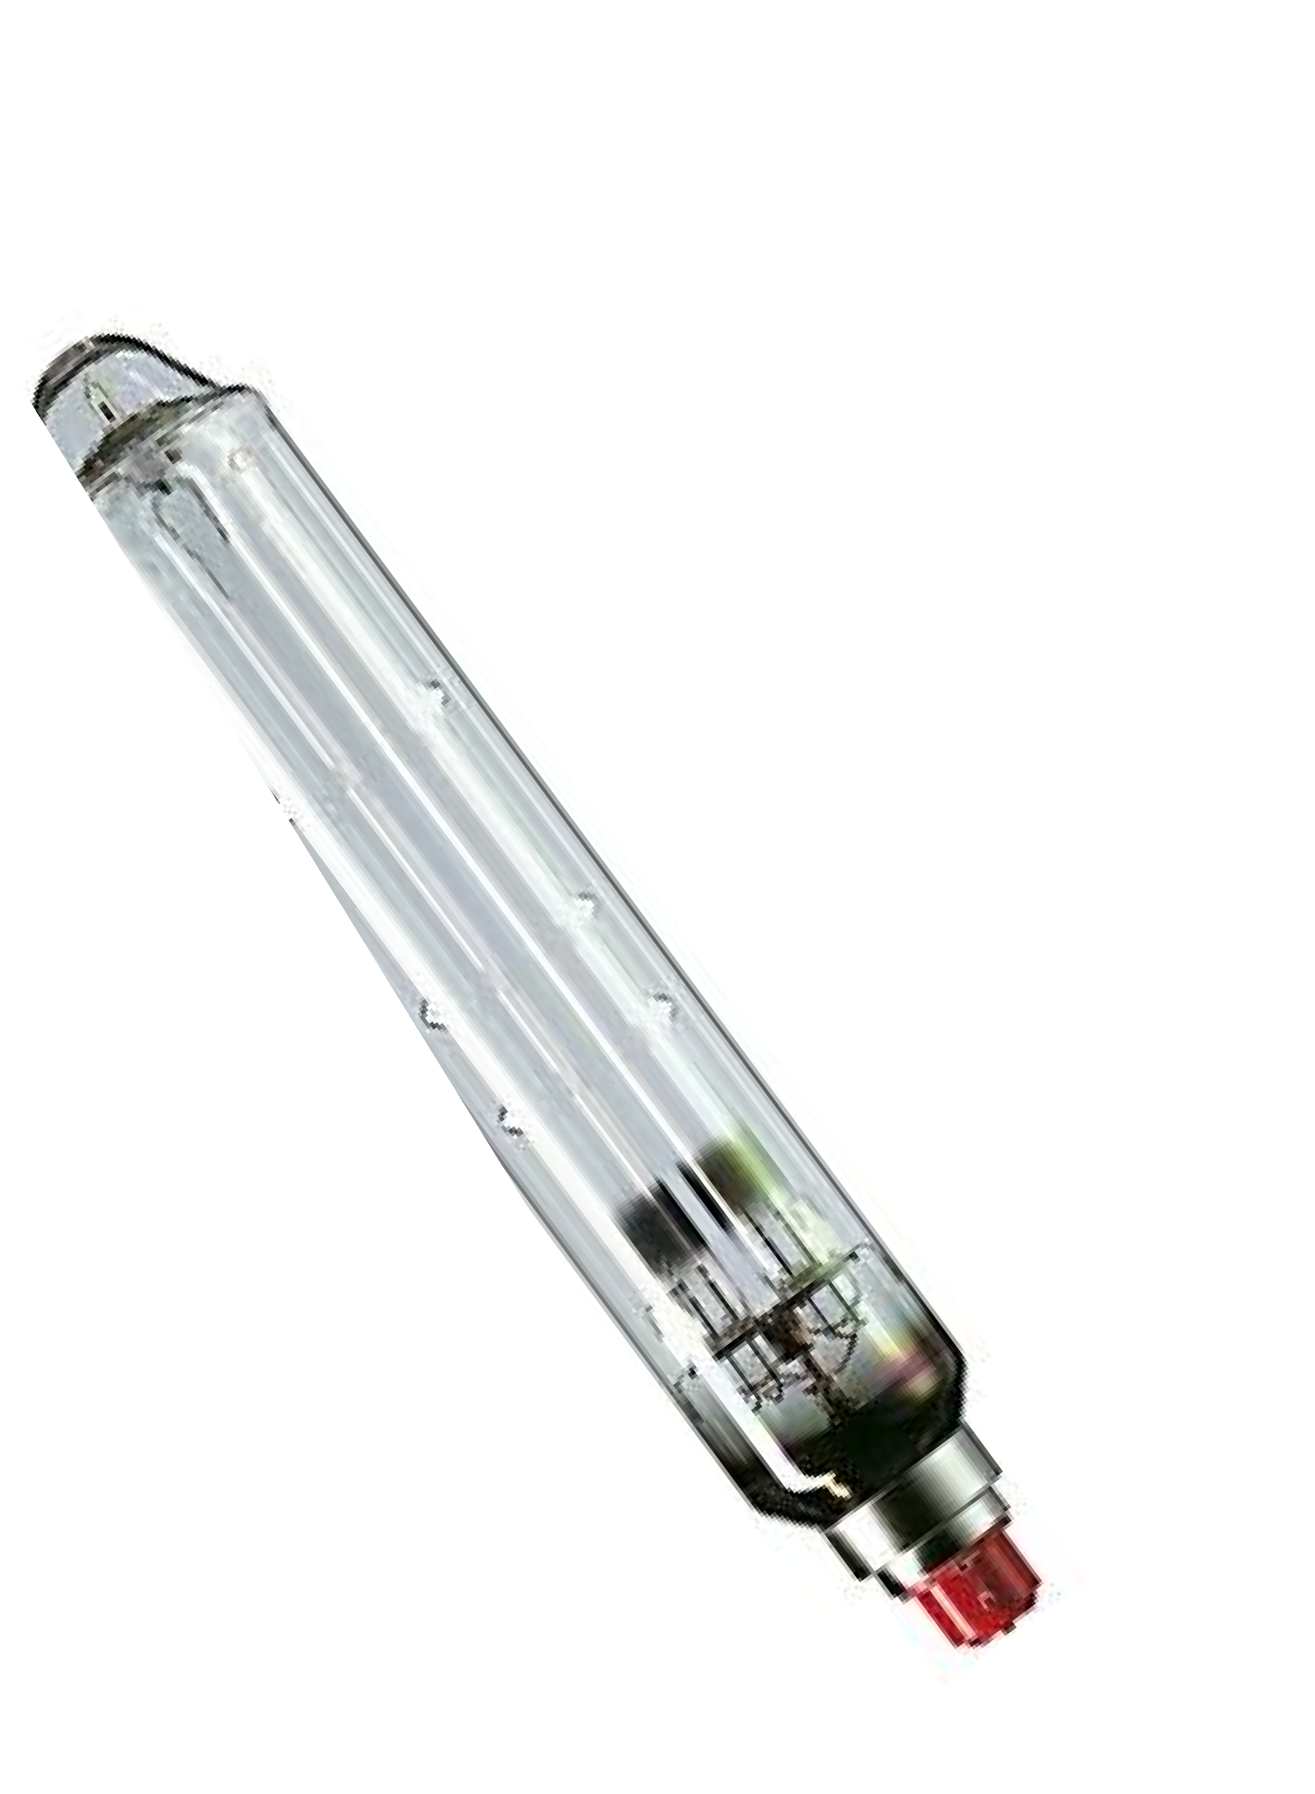
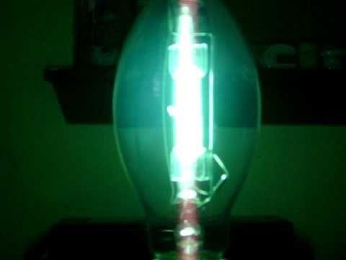
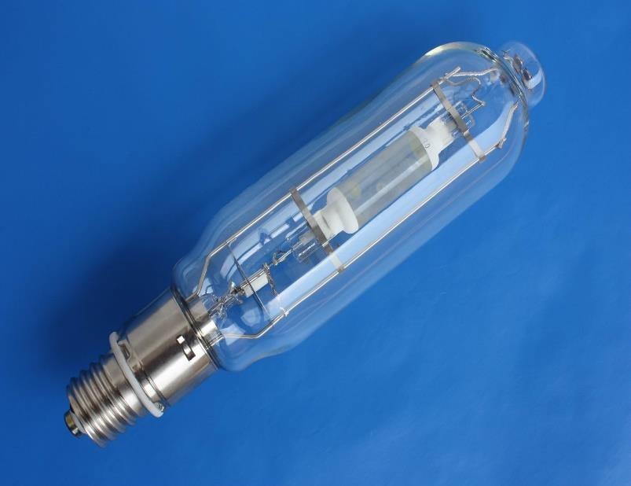
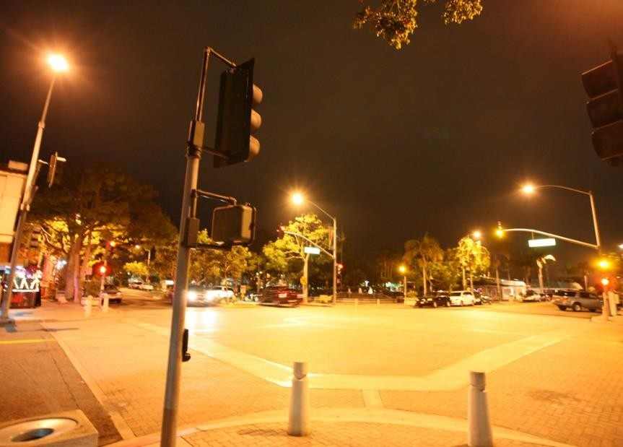
7.2 Security Lighting
Lamps
Mercury Vapor – Gas entrapped, 30-60 Lpw, 20,000 hours
Metal Halide – Electrical lamp with electric ara, Gas entrapped, 80-100 Lpw, high cost of maintenance
High Pressure Sodium – Vaporized Sodium metal with Gas entrapped, 100 Lpw, Parking Lots, Roads
Low Pressure Sodium – Gas entrapped, 150 Lpw, very costly to maintain, Street/Tunnels, Lab Experimental

Slide 7
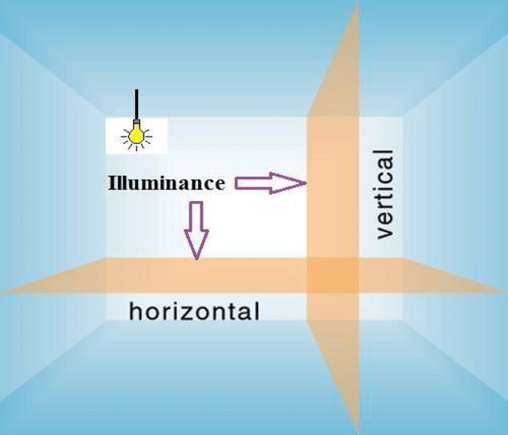
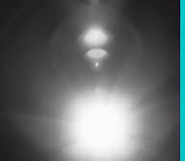
7.2 Security Lighting
Points to consider for Lamps: Horizontal/Vertical Illuminance, Uniformity/Shadows, Glare
Consider following:
Safeguard of resource and personnel
Crime history that the organization might have
Crime ration in the are
Surrounding area
As per physical security analysis or survey
Complaints made by all stakeholders

Slide 8
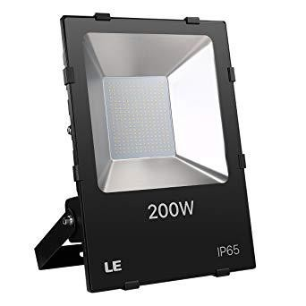
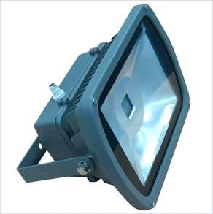
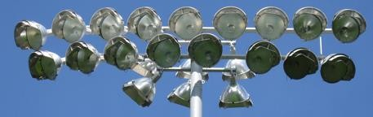
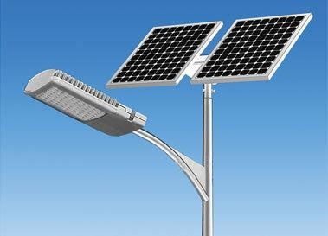
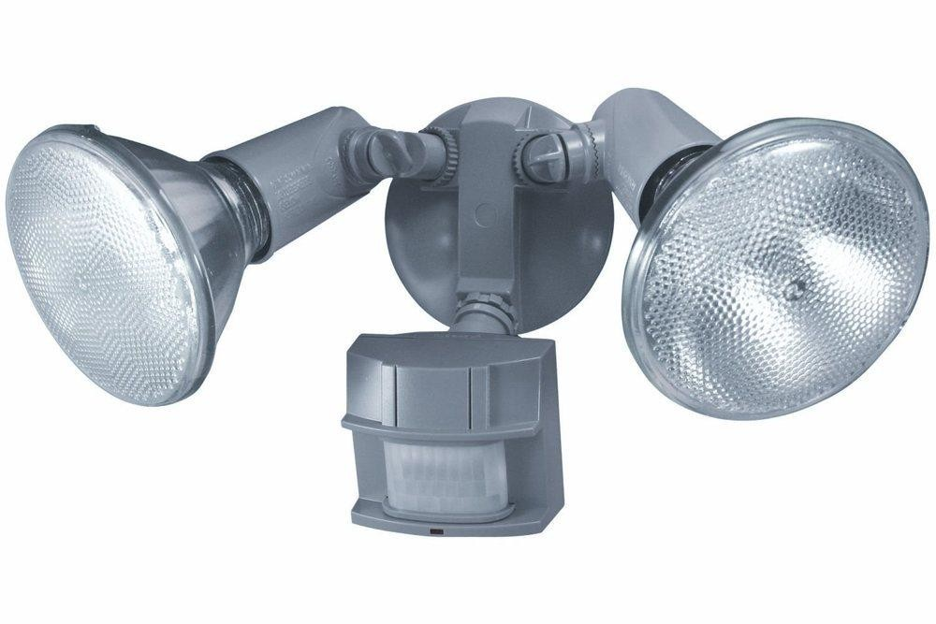
7.2Security Lighting
Other Lighting Equipment → Flood Lights – Wide beam flooding an area with its illuminance, gaseous
Points to consider for Flood Lights:
Lamps mounted high / poles
Power lines buried
Protective covers on lamps
Switch box locked
Use natural lights – photovoltaic – on-off depending on surrounding natural light
Use motion sensor – internal / external

Slide 9

7.3 Alarm Systems

Slide 10

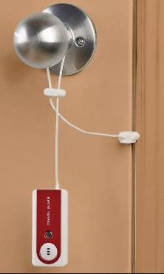
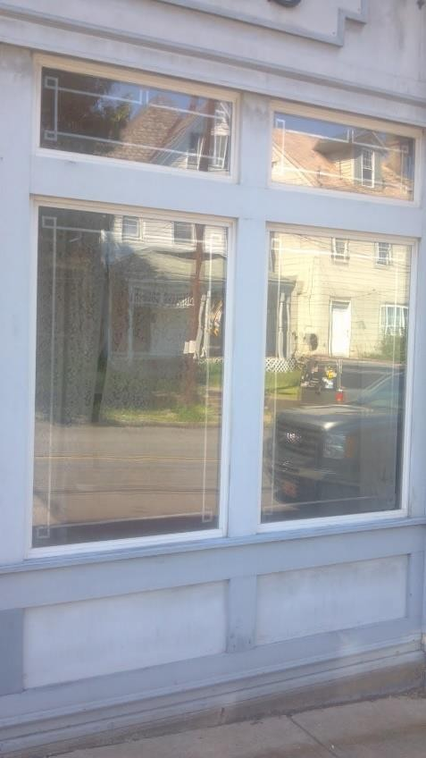

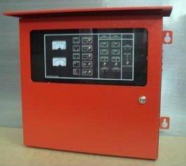
7.3 Alarm Systems
Types of Alarms: Perimeter, Area and Spot Protection
Perimeter Protection Alarms
Door switches - on top of door with magnet which moves towards a switch that activates an alarm
Metallic Foil - for showroom with window tape, alerts when tape breaks when glass is tempered
Glass break detectors – alert when glass breaks due to shock or sound
Wooden Screens – 4” apart, made of wood
Window Screens – on windows, go off when wire is cut
Lace & Panel

Slide 11
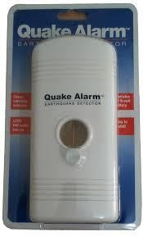
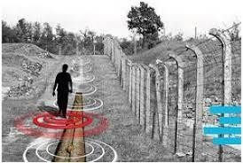
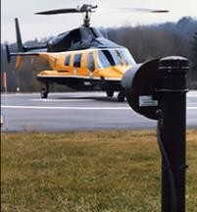
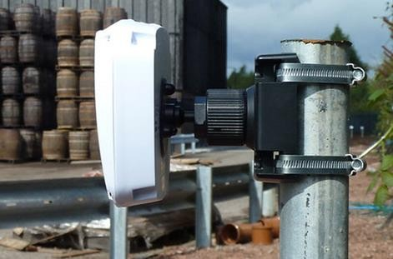
7.3 Alarm Systems
Types of Alarms: Perimeter, Area and Spot Protection
Area Protection Alarms
Ultrasonic
Microwave
Infrared:

Slide 12
7.3 Alarm Systems
Types of Alarms: Perimeter, Area and Spot Protection
Area Protection Alarms
Ultrasonic – low freq. (23-26Khz) sound waves, covers 5 to 40 feet,
Problems:
- Wind draft & turbulence
- humidity or temperature
- Smooth surface will reflect
- Bells, air hissing telephone cause noise
- Signals absorbed lead to decrease in sensititvity

Slide 13
7.3 Alarm Systems
Types of Alarms: Perimeter, Area and Spot Protection
Area Protection Alarms
Microwave – volumetric, vibrations, 0.3-300 GHz, using radio freq.
Problems:
- Metal objects movement
- Thin walls and glasses
- Surface movement due to vibration

Slide 14
7.3 Alarm Systems
Types of Alarms: Perimeter, Area and Spot Protection
Area Protection Alarms
Infrared – passive sensors, detect infrared radiation, human body radiations
Problems:
- Rapid change in temperature
- Sensitivity to environment
-Smooth surface reflection
- Solid surfaces block the radiation

Slide 15
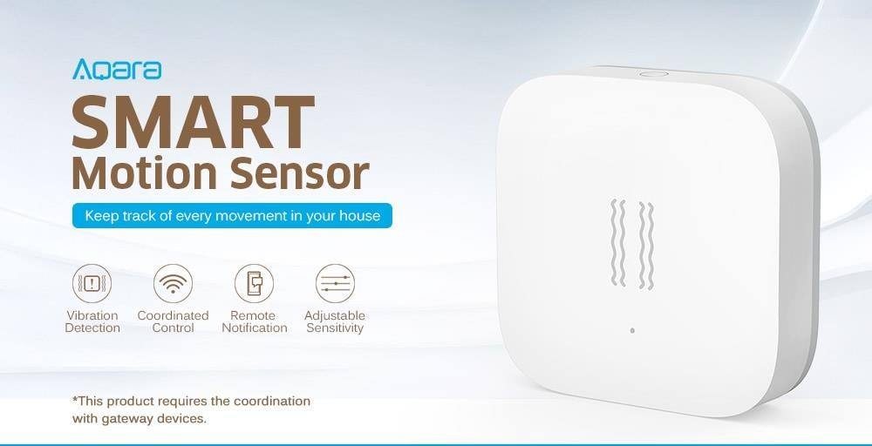
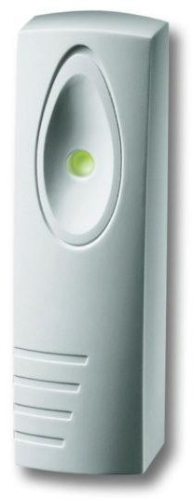
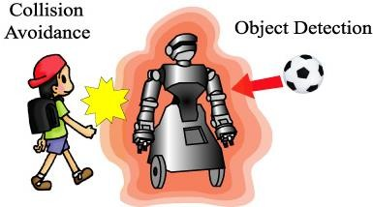
7.3 Alarm Systems
Types of Alarms: Perimeter, Area and Spot Protection
Spot Protection Alarms
Protect: Filing cabinets, Safes, Art objects, Desks, Statues Models, Expensive Equipment
Proximity detectors – electronically linked antenna → unbalance in electrostatic field → alarm triggers
Vibration detectors – specialized sensitive microphones → electronic vibrations detectors (EVDs)

